Slide 1

BUSINESS ANALYSIS Agile, Scrum Roles & Backlog

Slide 2
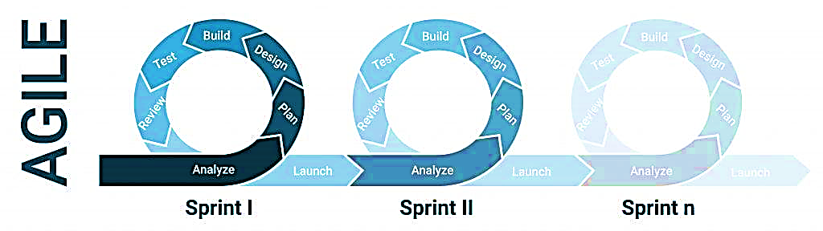
AGILE OVERVIEW
What is Agile Methodology: A project management framework that breaks projects down into several dynamic phases, known as sprints.
Why use Agile: To accommodate shifting needs and priorities of customers
How it works: An iterative process in which teams set goals for each sprint, then build, test, and review their work with stakeholders before moving to the next sprint.
Source: asana; https://asana.com/resources/agile-methodology
IT Chronicles: https://itchronicles.com/agile/agile-methodology-what-it-means/

Slide 3
AGILE CONCEPTS
“Sprint: A short work cycle, usually one to four weeks, where teams commit to completing specific tasks.
Product backlog: A prioritized list of features, fixes, and tasks that guide what the team will work on next.
Sprint backlog: The selected items from the product backlog (prioritized list of functions) that the team plans to finish.
Standup: A short daily meeting where team members share progress, plans, and roadblocks.
Iteration: A repeated cycle of planning, building, testing, and reviewing work to improve outcomes.
User story: A brief explanation of a feature from the end user's perspective, often used to define requirements.
Epic: A large work item made up of multiple user stories that span several sprints.
Velocity: A metric showing how much work a team completes in a sprint, often measured in story points.
Burndown chart: A visual tool that tracks remaining work against the time left in a sprint or project.
Work in progress (WIP): The tasks currently being worked on; limiting WIP helps prevent bottlenecks and delays.”
Source: asana; https://asana.com/resources/agile-methodology

Slide 4
FOUR PILLARS OF AGILE
Individuals over processes and tools. Agile teams value team collaboration and teamwork over working independently
Working software over comprehensive documentation. The software that Agile teams develop should work; additional work, like documentation, is not as important
Customer collaboration over contract negotiation. Customers are extremely important within the Agile methodology; customer collaboration is more important than the finer details of contract negotiation
Responding to change over following a plan. Agile project management is very flexible; allows teams to quickly shift strategies and workflows without derailing an entire project.
Source: asana; https://asana.com/resources/agile-methodology

Slide 5
DIFFERENT TYPES OF AGILE METHODOLIGIES
Kanban is a visual approach to Agile; teams use online Kanban boards to show work in progress as tasks move through each stage of development.
Scrum is a popular Agile methodology used by small teams and also involves sprints.
The team is led by a Scrum master whose primary role is to remove obstacles so team members can focus on their daily tasks.
Scrum teams hold daily meetings to discuss ongoing tasks, roadblocks, and other issues that might impact the development process.
Extreme Programming (XP) emphasizes team values to improve collaboration. It has 5e core values that guide how developers interact and make decisions throughout the project:
Communication
Simplicity
Feedback
Courage
Respect
The Adaptive Project Framework acknowledges that unknown factors can emerge and budgets, timelines, and team composition may have to be modified
Source: asana; https://asana.com/resources/agile-methodology

Slide 6
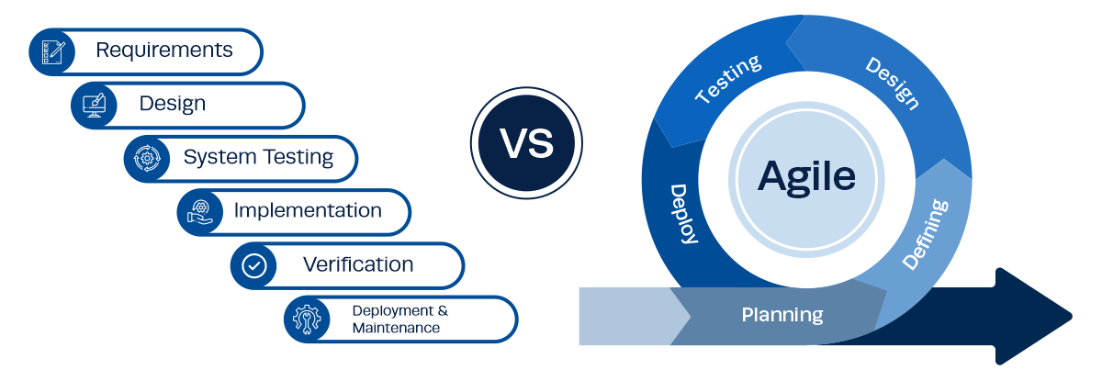
AGILE VS. WATERFALL METHODOLOGY
WATERFALL
AGILE
Source: Institute Project Management; https://instituteprojectmanagement.com/blog/waterfall-methodology/

Slide 7
SCRUM ROLES
The product owner maximizes the value the product creates; defines the why, who, and what—why it is worthwhile to develop a product, who it is for, and what features it should contain.
Set product goals
Ensure that the product backlog is stocked with clearly expressed items that help reach the product goal
Order the backlog
Regularly update and refine the backlog together with the developers
Collect feedback from users, customers, and stakeholders on the product increments
Agree on sprint goals with the developers
The development team creates products with the right quality; comprises a small team (2 to 3 people) that is:
Self-organizing
Cross-functional
The scrum master coaches the product owner, developers, and stakeholders; he acts as a
Coach: Facilitate meetings, conversations, and improvements.
Protector: Run interference so the team can remain focused.
Leader: Lead without authority and puts the team first.
Advocate: Reinforce agile principles throughout the organization.
Source: SCRUMALLIANCE; https://resources.scrumalliance.org/Article/scrum-team

Slide 8
BACKLOG
What is a Backlog/Product Backlog in Agile?
A list that compiles all the tasks and user stories that must be done to complete the whole project
The sprint backlog is a subset of the product backlog and contains items that can be completed during each agile sprint.
What should be included in a Product Backlog?
User Stories & Epics: Descriptions of a feature or functionality from the end user’s perspective, e.g., “As a [user], I want [feature] so that [benefit].” Epics are larger user stories that require multiple sprints or tasks to complete and are later broken down into smaller, actionable user stories
Technical Improvements: Backend or infrastructure-related enhancements that improve system performance, scalability, security or maintainability. Examples include optimizing database queries or upgrading frameworks.
Spikes are time-boxed investigations or experiments to gain knowledge, reduce uncertainty or evaluate technical feasibility. They are often used when teams need to explore new technologies, architectural decisions or complex requirements before committing to implementation.
Non-Functional Requirements: These define system attributes such as performance, reliability, scalability and security.
Dependencies & Constraints: Dependencies are tasks that rely on completing other work items before they can be implemented. Constraints refer to limitations such as budget, time, regulatory requirements or technical restrictions that influence how a product is developed.
Story Points: Story points are a unit of measure used to estimate the effort required to complete a task or user story. They consider complexity, risk, and time, helping teams gauge workload and prioritize tasks without relying on exact time estimates.
Acceptance Criteria: The specific conditions and requirements that a product or feature must meet for it to be considered acceptable by stakeholders.
Backlog Items Priority Levels and Status: Backlog items’ priority levels and status help teams organize and track work in an agile backlog. Priority levels (e.g., high, medium, low) define importance, while status (e.g., to-do, in progress, done) indicates progress toward completion.
Source: ProjectManager; https://www.projectmanager.com/blog/product-backlog-sprint-backlog

Slide 9
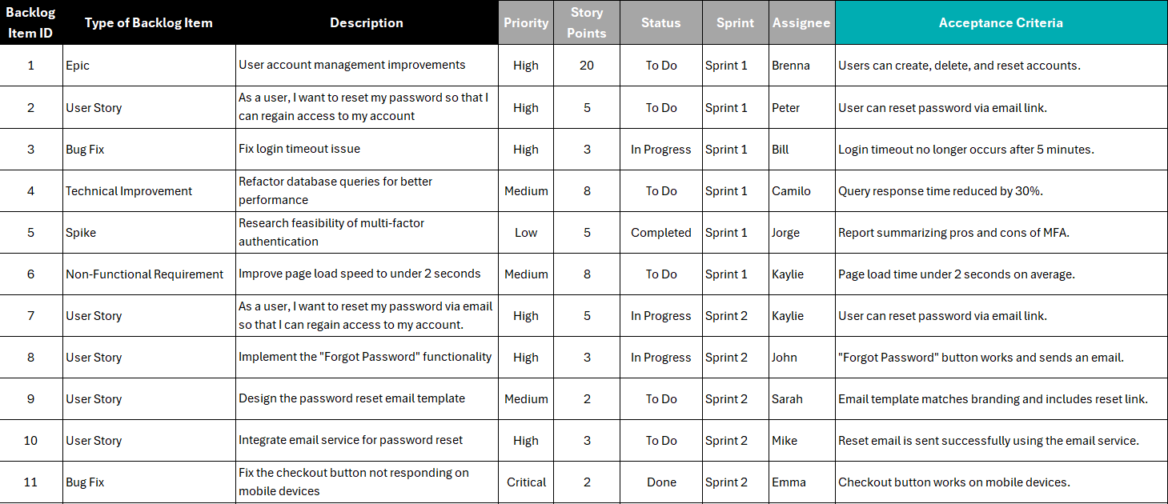
BACKLOG EXAMPLE
Source: ProjectManager; https://www.projectmanager.com/blog/product-backlog-sprint-backlog

Slide 10
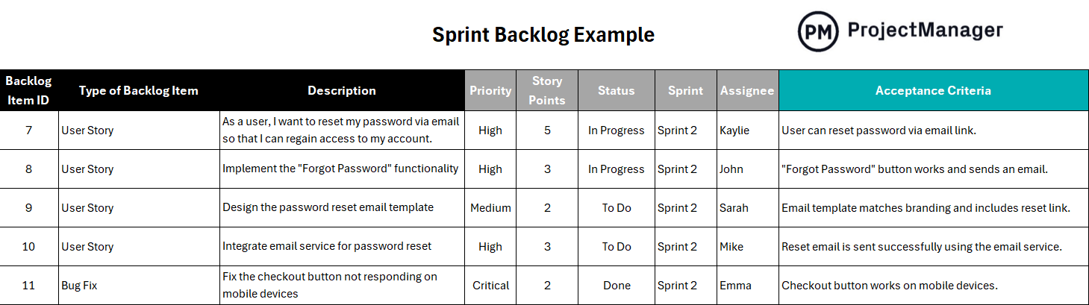
SPRINT BACKLOG EXAMPLE
Source: ProjectManager; https://www.projectmanager.com/blog/product-backlog-sprint-backlog

Slide 11
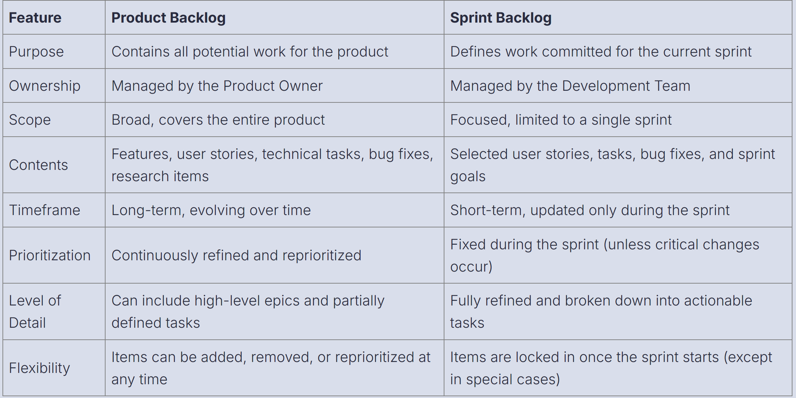
PRODUCT BACKLOG VS. SPRINT BACKLOG
Source: ProjectManager; https://www.projectmanager.com/blog/product-backlog-sprint-backlog

Slide 12
REAL WORLD EXAMPLES OF AGILE METHOD
PayPal
Problem: The company had become disorganized, bottlenecked, and slow to release new products.
Strategy:
A team of 150 was assembled; coaches were engaged and formal training provided to thousands of employees.
A Scrum model was used and hundreds of cross-functional teams aligned around a two-week “sprint” (work) cycle.
Results/Outcome: Within six months, the company had delivered 58 new products.
Cisco
Problem: The waterfall methodology was inefficient and created delays.
Strategy: Cisco implemented SAFe for its Subscription Billing Platform as part of a broader shift to Agile methodologies
Cisco created three Agile Release Trains: Capabilities, Defects/Fixes, and Projects.
Teams coordinated for 15 minutes each morning to share progress and determine priorities, which enabled greater cohesion.
Results/Outcome:
Workflows accelerated, overtime hours decreased, employees felt better overall.
There was 40 percent reduction in defects
There was 14 percent improvement in Defect Removal Efficiency.
Source: smartsheet; https://www.smartsheet.com/content/agile-project-management-examples?srsltid=AfmBOopMdRNNTKAQvCZlYrbx7yQp5P_D7eSP8tDyAUe3OEaNwdaFxN9s

Slide 13
ACTIVITY
Imagine a hypothetical situation in which a business is facing declining profits and you are called upon to analyze the problem as a BA
Describe the situation
Provide descriptive statistics relevant to the situation, and perform
Diagnostic analysis
Predictive analysis
Prescriptive analysis
Using the prescriptive analysis as a guide, describe the agile methodology you will use for your project to resolve the business problem and the sprint activities for four teams
Last, describe four backlog items related to your project in the following table
Backlog Item No. | Type of Backlog item | Description | Priority | Story Points | Status | Sprint | Assignee | Acceptance Criteria

Slide 14
ESSENTIAL READINGS
ACCOUNDEMY: “Introduction to Financial Accounting and The Financial Statements”, available at https://accountdemy.com/introduction-to-financial-accounting-and-the-financial-statements/
DATAPATROL: “Business data”, available at https://datapatrol.com/business-data-why-is-it-important-for-your-organization/
indeed: “What is data in business”, available at https://www.indeed.com/career-advice/career-development/data-in-business
Qlik: “Financial analysis”, available at https://www.qlik.com/us/data-analytics/financial-analysis

Slide 15
REFERENCE BOOKS OPTIONS
BUSINESS ANALYSIS BODY OF KNOWLEDGE (BABOK); IIBA Bookstore: https://www.iiba.org/career-resources/a-business-analysis-professionals-foundation-for-success/babok/
BUSINESS ANALYSIS (Fourth Edition) by Debra Paul (Author), James Cadle (Author), Malcolm Eva (Author), Craig Rollason (Author), Jonathan Hunsley (Author)
BUSINESS ANALYSIS TECHNIQUES: 123 ESSENTIAL TOOLS FOR SUCCESS (3RD Edition) by James Cadle (Author), Debra Paul (Author), Jonathan Hunsley (Author), Adrian Reed (Author)

